Slide 1

LuxaOS & LuxaMatrix MRP Meeting – 28.11.2025

Slide 2

Our Project
Project Name
MS-107317_LuxaOSLuxaMatrix
Team Size & Project Category
Team Size – 8
Customer
(DC-JS/ETI2)
Category – D
Contract Validity
31.12.2026
Tools & Technology
Angular 20,HTML,CSS,NodeJS,C#,AzureDevOps,Robot Framework , Python
Life-cycle
Agile-Scrum (3 weeks sprint)

Slide 3

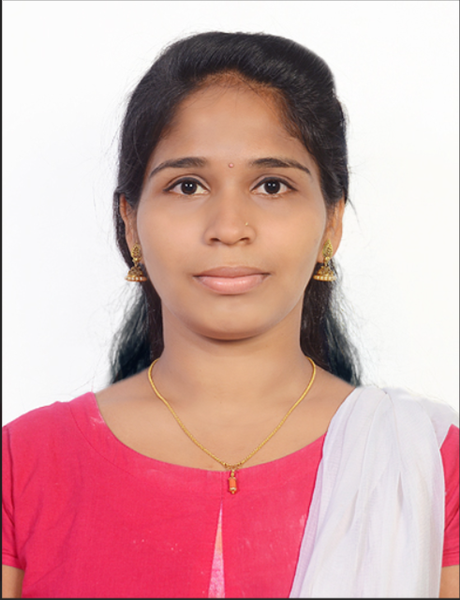
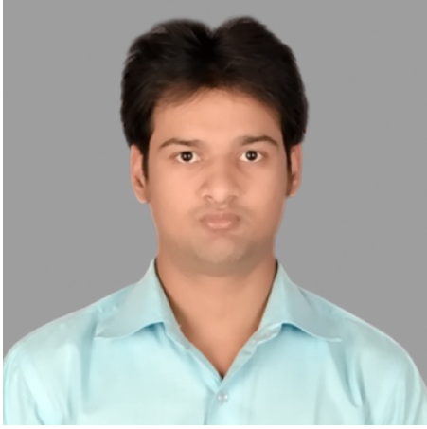
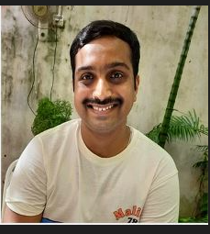


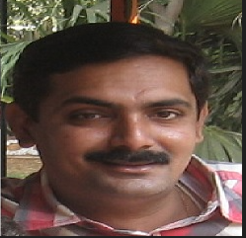





Team Composition
LuxaOS LuxaMatrix
LuxaOS &LuxaMatrix Development Team
Bosch Rexroth in Murrhardt is supplier of various device
types of industrial nutrunner in stationary or handheld forms
LuxaOS Focuses on developing the next generation of
tightening systems after Nexo1
Scope of BGSW is to develop a web-based GUI that
Can be deployed in the stationary system too. So, at the end
we have only one GUI for the complete portfolio
The tightening platform also known as joining platform, is
an application system based on ctrlX Automation.
In particular, joining-specific apps are deployed on a
ctrlX-based platform. The joining-specific apps provide further
benefit to customers, in addition to existing portfolio.
Dhruv Kalia
Product Owner
Sathyavathi
Developer
Rohit
Developer
Harshavardhan VS
Developer
Gurudath
Developer
LuxaMatrix App
Technologies:
Angular 20+,HTML,CSS,ReactJS
NodeJS
Python
C#,.NET Core
REST Framework
Robot Framework
Azure DevOps – Continuous integration with automated build pipelines
Docker
Samita
Project Manager
Satya
CI-CT Architect
Tariq Ahmed
Architect
Vaishnavi
Developer
Karthik
Apprentice
Yash
Apprentice
Jayanth B R
EPQ

Slide 4
Our Business Partners
LuxaOS – Front End Development for Nexo and AxoControl)
Product Owner – Dhruv Kalia(DC-JS/ETI2)
Tester – Andreas Kroetz(DC-JS/ETI2) and Thomas Wahl(DC-JS/ETI2)
Backend Developers – Volken(DC-JS/ETI2) ,Abha Rai(DC-JS/ETI2) and Rick Thiele(DC-JS/ETI2)
DevOps and Security – Alexander Sailer (DC-JS/ETI2) and Heiko Schmidt(DC-JS/ETI2)
BS350 Features – Grueter Jens(DC-JS/ETI2)
LuxaMatrix - Platform
Requirement and Product Development-Christian Feder(DC-JS/ETS2)
Bjoern- TASS connectivity development(DC-JS/PRM-T)

Slide 5
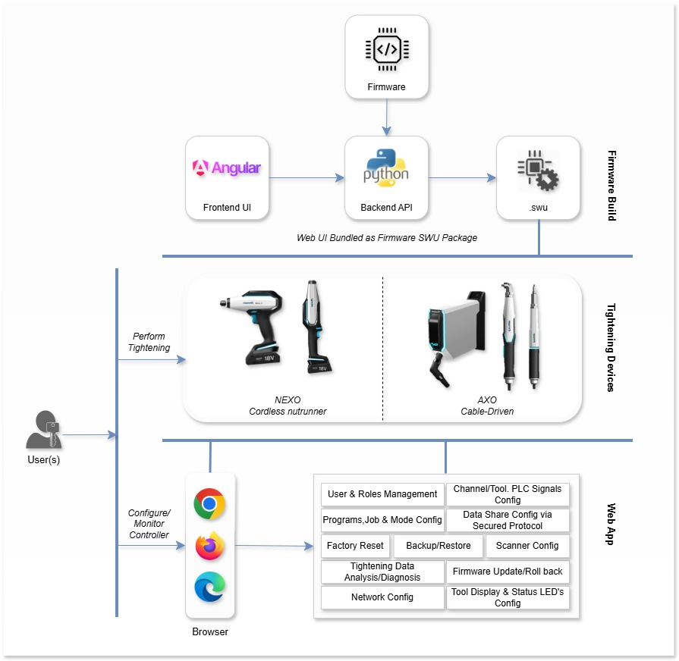
Tightening Product Scope
Current Scope:
V4.00. SP2, SP3, SP4,V4.01
Future Scope:
V4.02, V4.*

Slide 6

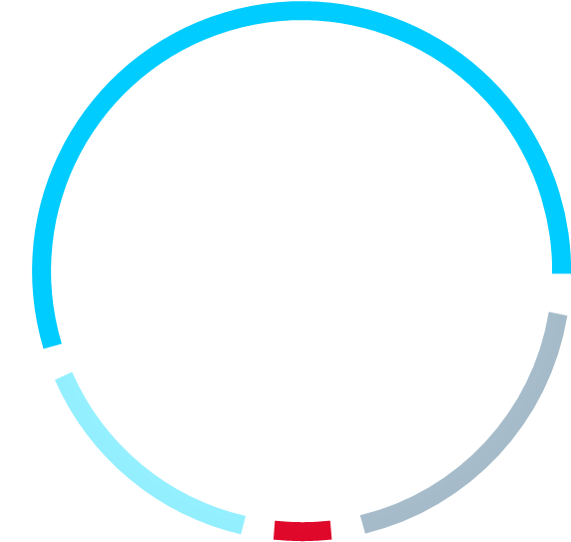
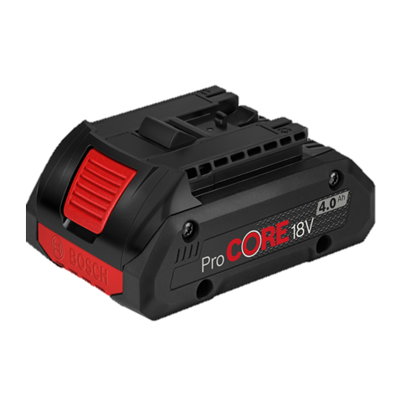
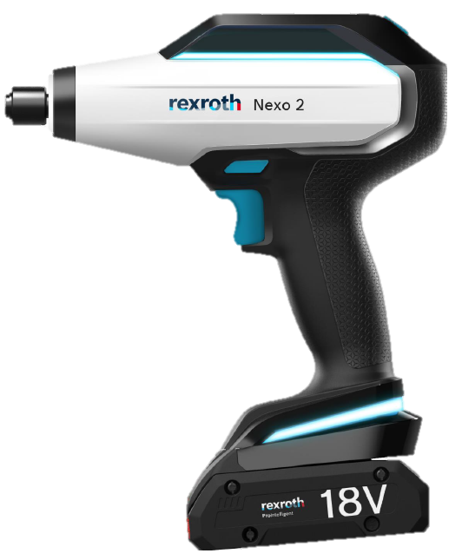


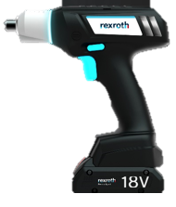
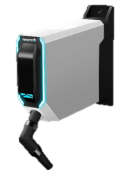
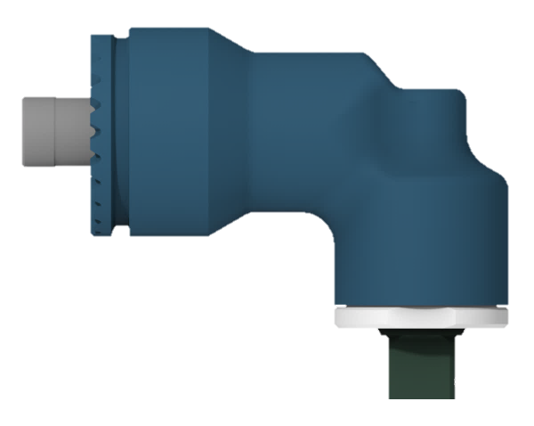
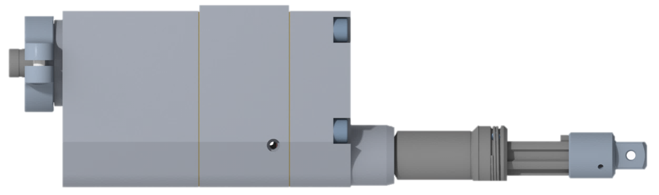
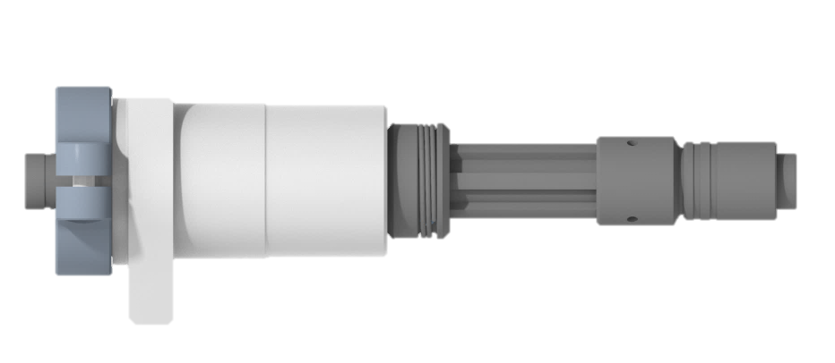
Bosch Rexroth Joining Technology
Universal
CABLE
Product Communality
PLATTFORM
Standard
Bosch
for all tools
BATTERY
NEXO and Exact
for
Universal
SOFTWARE
PLATTFORM
for all tools
- browser based
Universal
CONTROLLER
for all cabled tools
OUTPUT
One
Unified
DISPLAY
DRIVES
for all tools
for all tools and controllers
Unified
WIFI
Unified
CONTROLLER
MODUL
ELECTRONICS
in NEXO and CONTROLLER
in NEXO and CONTROLLER

Slide 7
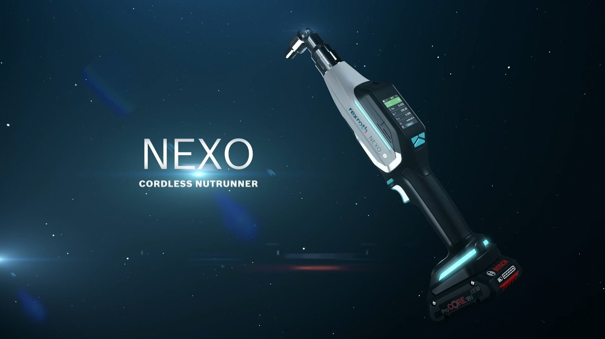

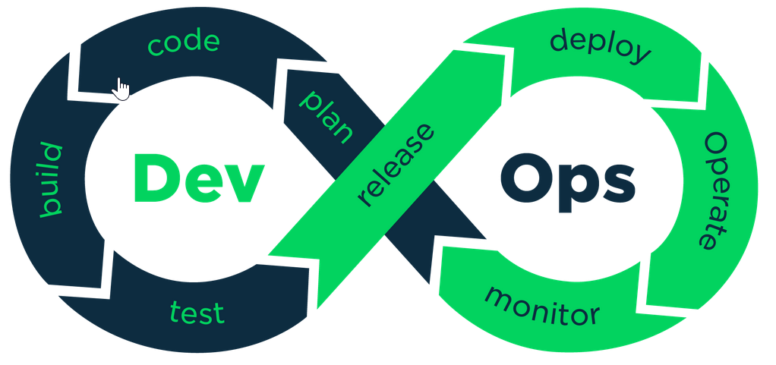

DC-JS – Support From BGSW
BGSW In-Scope
Front end web development for
configuration of the tool
Test automation using Robot framework
Azure DevOps (CI/CD)
Technology stack: Angular,HTML,CSS Robot framework
BGSW Out-Scope
Back end using Python
Firmware development(C++)
NEXO2
BGSW In-Scope
Front end web development for
configuration of the tool(Replacement of old BS350 s/w)
Technology stack: Angular 20+,HTML,CSS,AzureDevOps
BGSW Out-Scope
Back end using Python
Firmware development
AXO Control
Front End and backend build pipeline automation
PR Based Testing framework
Multi-Environment Firmware Build Automation
Comprehensive static code analysis integration
Integrated test cases with feature
Test reports generation
Test automation pipeline weekly builds

Slide 8
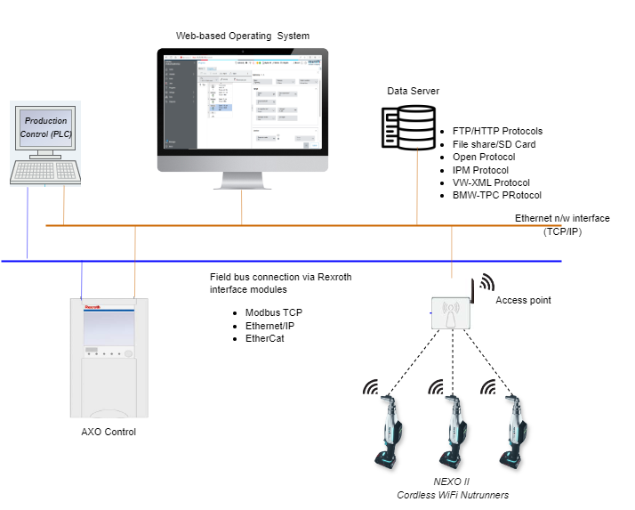
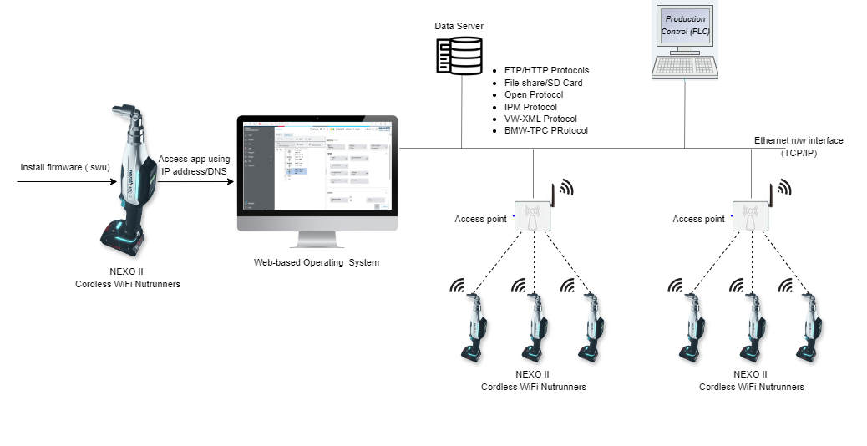
Architecture – Nexo and AxoControl
NEXO II
AXO Control

Slide 9
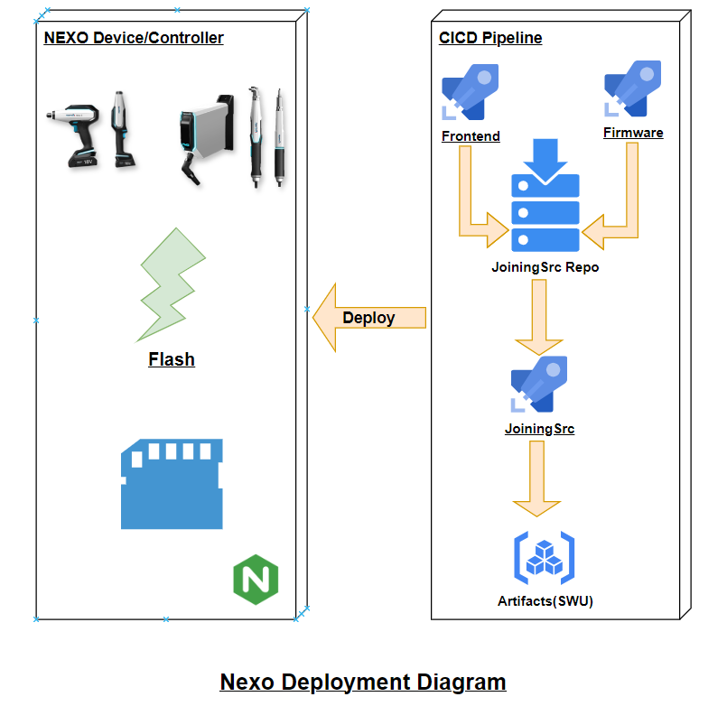
Nexo – Deployment Diagram

Slide 10
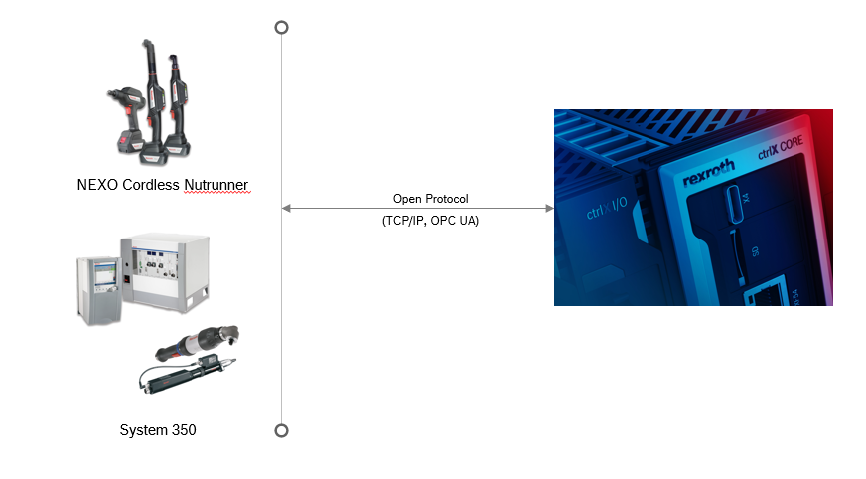
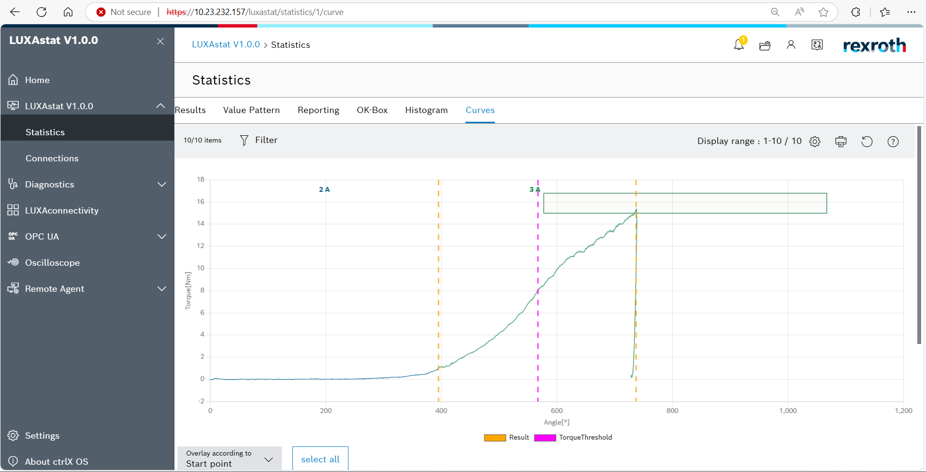
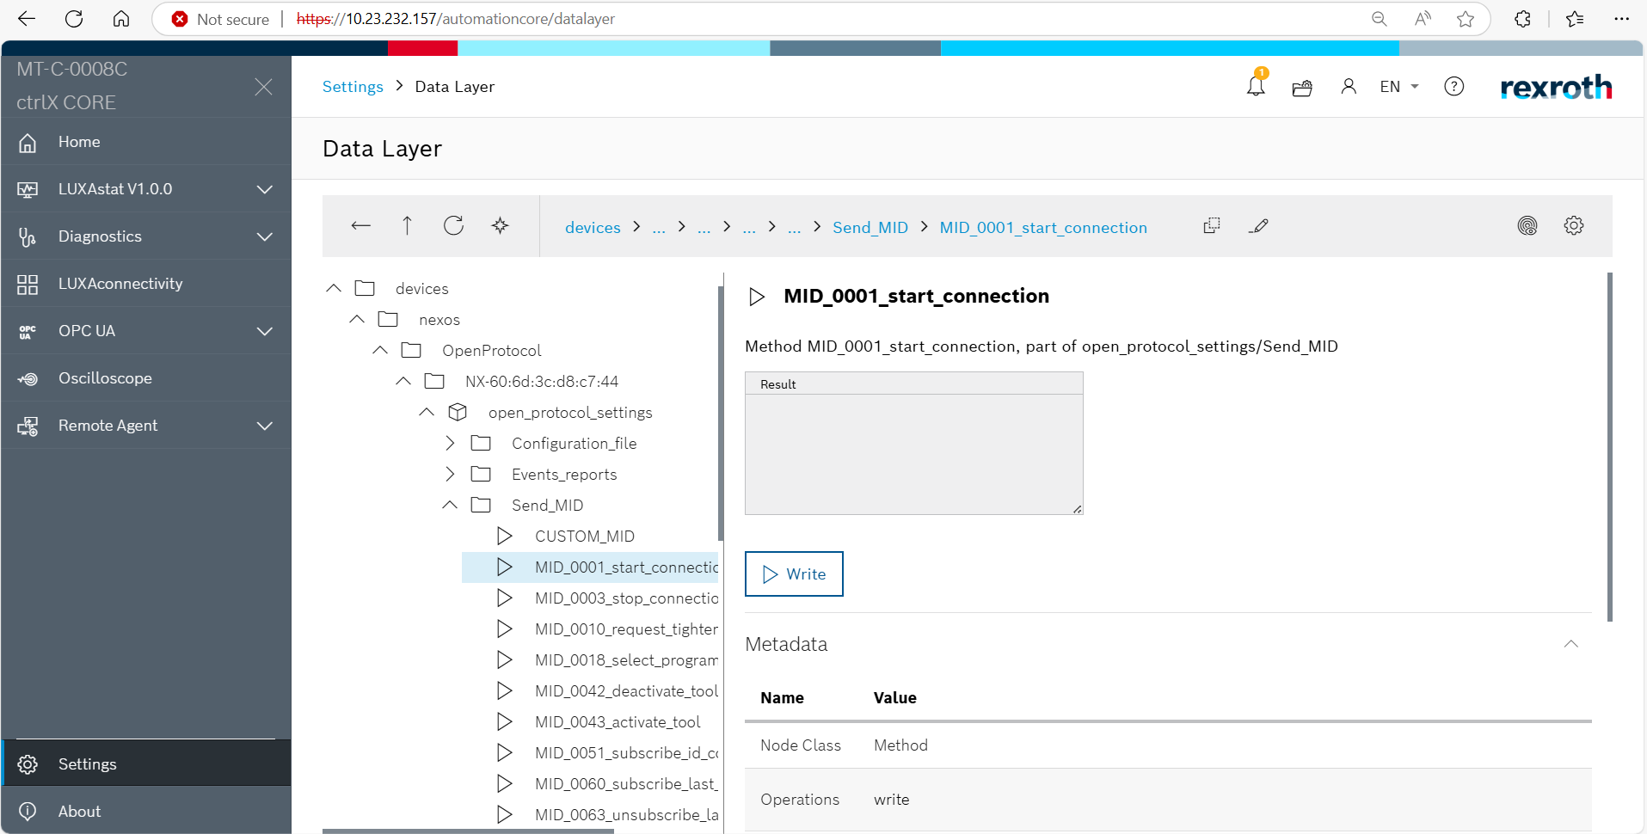
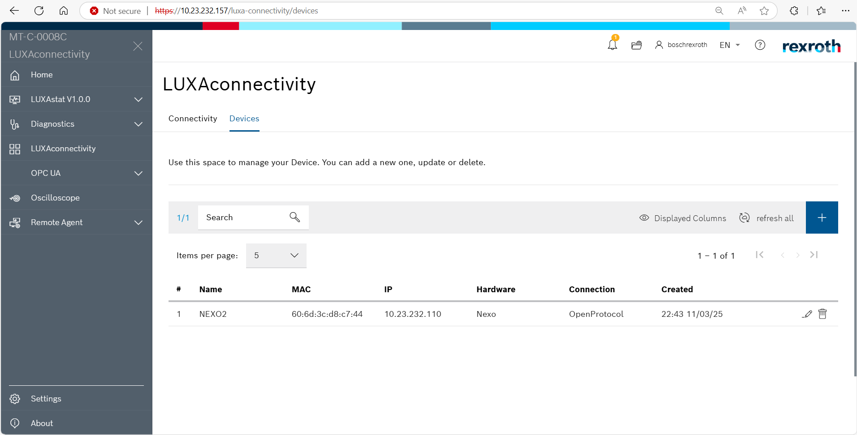
LUXAMatrix
Key Features
Advanced statistical analysis of tightening results
from NEXO and System 350 devices on ctrlX hardware
Hassle-Free installation & operation – run on
CtrlX Core hardware
Key Features
Communication b/w CtrlX Core and Tightening
devices (NEXO, System 350, OPEX, etc.,)
Continuous synchronization of tightening results data
Licensing & access control
Hassle-Free installation & operation – run on
CtrlX Core hardware
Other app can retrieve the tightening results through
Open protocol
LUXAStat
BGSW In-Scope
Full responsibility
Software E2E development
OCaaS Scan
Azure DevOps(CI/CD)
App validation
Technology stack: NodeJs, Angular,C#
Azure DevOps
LUXAConnect
LuxaUpdate
Key Features
Communication b/w CtrlX Core and Tightening
devices (NEXO, System 350, OPEX, etc.,)
Firmware Update to All the devices using once click
Key Features
Predictive Maintenance of the products
LuxaMaintenance

Slide 11
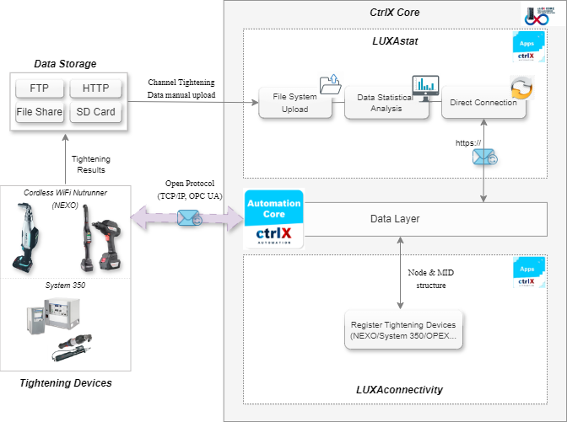
Architecture – LuxaMatrix

Slide 12
Journey So Far
LuxaOS v4.01.STD.Release
LuxaStat v1.0.0 Release
Major release with QGR
LuxaOS v4.00.STD.SP2Relaase
LuxaOS Project Kick off
Major release with UX changes
Nexo1 FE migration to LuxaOS
LuxaMatrix Apps development.
.
2020
2023
2025
2026
2021-2022
2024
2025-Nov
2026-TBD
LuxaOS FE Development
LuxaOS v4.00.STD.Release
LuxaOS v4.00.STD.SP4 Release
LuxaOS v4.02.Release
Nexo2 1st version release.
AxoControl features on LuxaOS platform.

Slide 13

LuxaOS roadmap
Migration of all features from Nexo1 web app to LuxaOS FE
IPM Screen
Offline Screen
WLAN screen
Plausibility checks
Mode/Jobs/programs update
NTP server screen
Yet to Start
Completed
In Progress
Delayed
Angular updates to v20
UX Enhancements
Favorite Feature
Menu Structure Change
Connected System Detection
Login Backend Images
V4.00.STD.SP2.Release
v4.00.STD.Release
Configuration- Validation Check
Iperf UI Design
Iperf Plausibility Implementation
v4.00.STD.SP1.Release
Angular 18 Upgrade
Console Errors in Diagnosis
Configuration updates
Bug Fixes
Plausibility Checks
IPM Screen
Online Help
Multilingual inconsistencies
Minor Bug fixes
V4.01.STD..Release
V4.00.STD.SP4.Release
Implementation of v.4.0.0.Release
Implementation of v4.01.Release
Oct-24 | Nov-24 | Dec-24 | Jan-25 | Feb-25 | Mar-25 | Apr-25 | May-25 | Jun-25 | Jul-25 | Aug-25 | Sep-25 | Oct-25 | Nov-25 | Dec-25

Slide 14
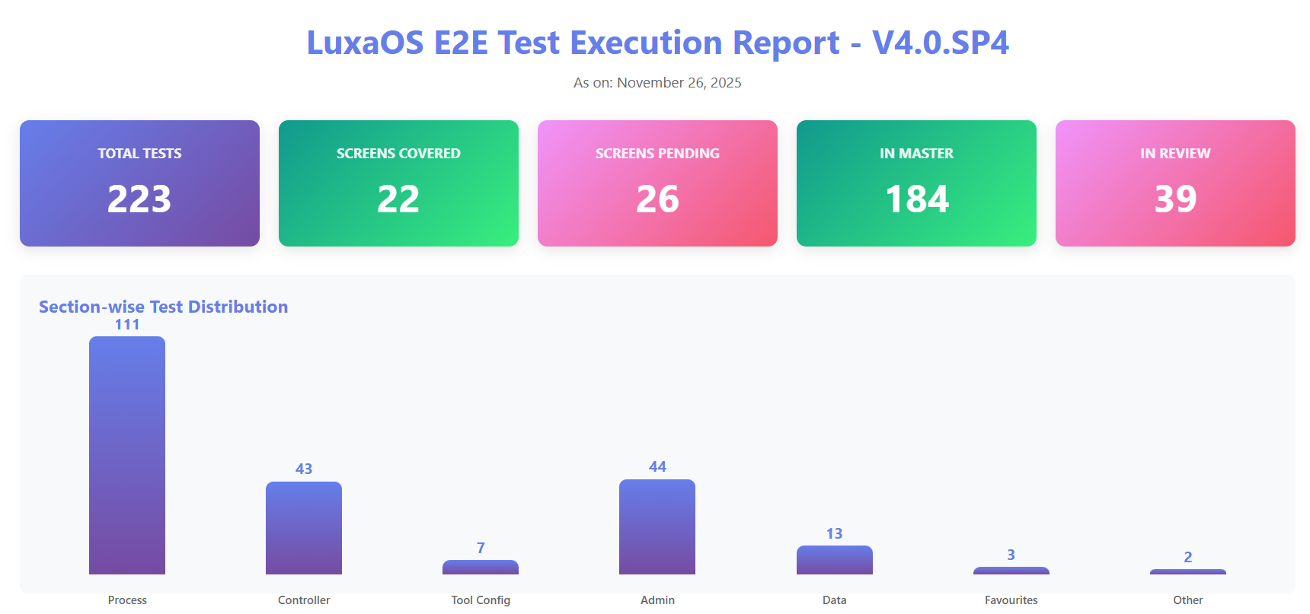
E2E Test Automation – 2025 Summary
 | Screens Covered | Total Test Cases
Jan- 2025 | 7 | 89
Nov-2025 | 22 | 223
Current Challenges:
Ensuring Consistent Availability of the Nexo Controller
Effective Communication to stakeholders post Test Execution
Further Improvements:
More organized reporting with increase in volume of test cases
Automating all the bugs reported under v4.01 under the test coverage

Slide 15







Azure Devops Automation – 2025 Summary
Integrated Frontend & Backend Build Pipeline
Frontend Release Test Automation
PR Based
Testing Framework
Multi-Environment Firmware Build Automation
Comprehensive
Static Code Analysis Integration
End-to-end automation synchronizing FE and backend builds with REST API-based branch validation and multi-repository coordination. parameterized builds with automatic version tagging and work item linking.
Run integrated robot tests on weekly basis and publish the results.
Test execution engine that analyzes code changes to dynamically select relevant Robot Framework tests from feature mappings.
Embedded firmware build system supporting multiple configurations (ST, FT, UT) in a single parameterized pipeline with HSM key management.
Integrated static analysis covering both frontend and backend with automated quality gate enforcement.
**Backend build pipeline process has reduced build time from ~4hrs to ~5mins eliminating human in loop once initiated

Slide 16

Key initiatives- 2025
Test Coverage
Improved Test Coverage by writing detailed test cases reports covering negative scenarios
Steps to enhance Quality
Requirement Elaboration
Impact Analysis, Implicit Requirements, and Nonfunctional Requirements documented by developers before starting any PBI/Bugs
Requirement Review
Detailed requirement review of every PBI by Architect
Code Review Optimization
Impactful Code review checklist integrated in PR
Notable Achievements
Test Automation Coverage
Pull Request Review Checklist Integration
Swagger Integration for documentation of all API’s

Slide 17
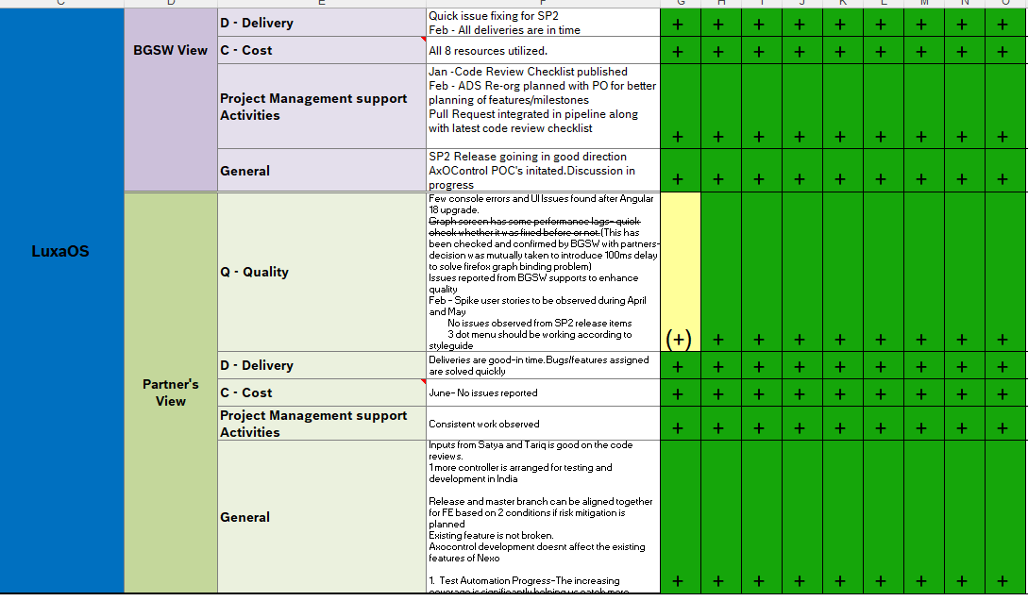
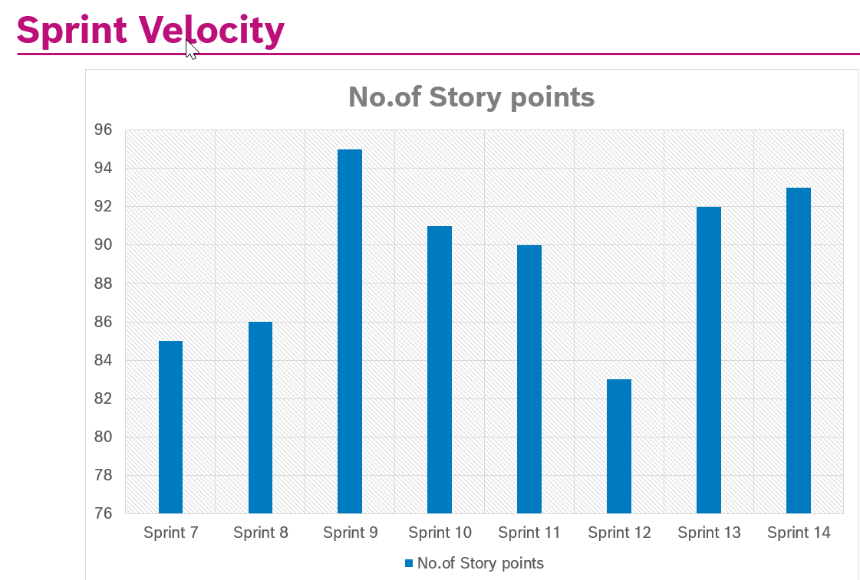
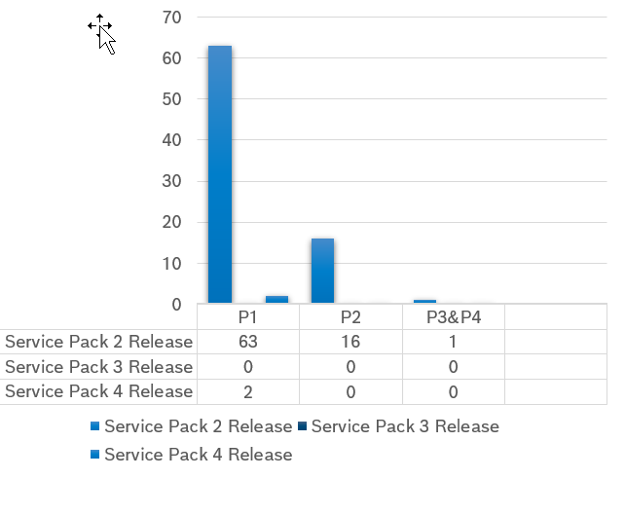
QCD 2025
Project Metrics
PEI Goals
Goals
Improved customer Defects | 39 customer reported defects
Defect Leakage | 12
Review Defects>Internal Defects | 124
No of defects found from regression cycle | 43
PQSR Status:
Defects

Slide 18
Challenges and Risks:
Description | Likelihood of the risk | Impact if risk occurs | Mitigation Action | Contingency Action
If LuxaMatrix platform concept is removed from DC-JS then scope of work reduces for BGSW team | Medium | High | LuxaStat integration is in discussion with DC-JS but entire risk cant mitigated | Further discussion with DC-JS on next steps
If Test Automation coverage is not 100 % for previous releases,risk of recurring bugs is open | Medium | High | Manual Regression test case will cover the rest of the modules | Further identification of steps to improve covereage

Slide 19

Highlights and Lowlights
Project Highlights
Project Lowlights
Discussions at DC-JS about removing LuxaMatrix are underway, with implications for future scope reduction
The release of LuxaOS v4.00 Service Pack 4 is complete
QCD’s green throughout the year except Jan
Partner's recognition of the team's consistent performance.
Production build automation enhances efficiency
5 Nexo hardware’s received this year,1 controller has been set up in the lab
The Nexo’s can be kept in India for next 1 year as per customs regulations

Slide 20
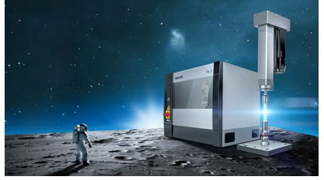
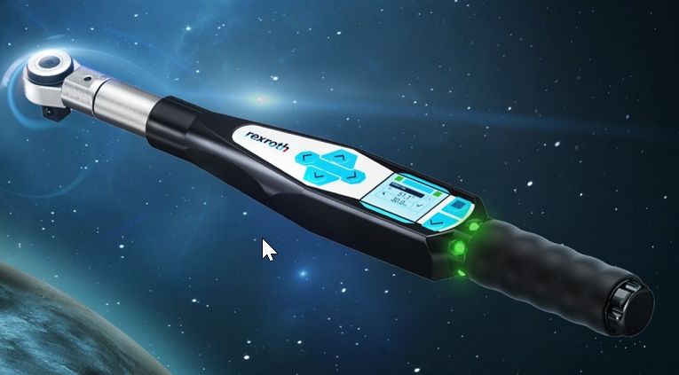
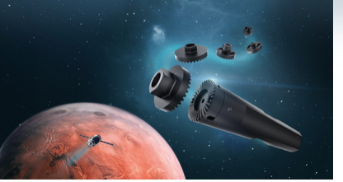
Tightening System – Product Portfolio – Not in BGSW Scope
Product Description
Technologies and Knowledge required
Intutive user interface that saves commissioning and engineering time using automatic drive control and parameterization
Can be used for Pressing,Joining,Crimping etc
Force Range of 2 to 30kN
Integration to Higher Level Machines Infrastructure using Field Bus protocols
Program Creating using web interfaces – drag and drop configuration
Web App Frontend Technologies like Angular,React for configuration of the drives
Backend technologies like C#,Python
Embeeded Programming Language like C/C++,Python
Embedded Development Tools
Communication Protocols -Field Bus Protocols,CAN,ModBus
Press Fit System
Enables measurement of both torque and angle during tightening process
Covers range of 3-800 Nm
Transfers Tighetning results to any IT system
WiFi based communication
Embeeded Programming Language like C/C++,Python
Embedded Development Tools
Communication Protocols -Field Bus Protocols,CAN,ModBus,Ethernet
Opex Torque Wrench
Embedded Systems Programming
Programming Languages – C/C++ to write firmware
Knowledge of specific hardware
Test Automation Software for Test Sequence and Handling
Data logging to memory card and communicate test results to Ethernet,USB etc
Networking and Communication Protocols
Torque Angle Slip standard testing system is pioneered method for testing the safety critical bolted joints
On the fly testing process, quality can be ensured during ongoing production
Operation Reliability
TASS Test System

Slide 21
1.
.
THANKYOU

Slide 22
Open Points

Slide 23
Journey so far
LuxaStat v1.00 Release(not to ctrlX store)
LuxaOS v4.00 Service Pack 1 release covering few internal defects
LuxaOS v4.01 Release with Nexo 2 and AxoControl as a unified platform
2024- Dec
2025-Feb
TBA
2023
2020
2025-March
LuxaStat App Development
LuxaOS v4.00 Service Pack 2 with Angular upgrade to 19.
LuxaStat v1.00 Patch Release
Nexo1 front end migration to LuxaOS
2024-Oct
2025-July
LuxaOS v4.00 Release covering all the functions from Nexo1 with additional features of Nexo2

Slide 24

Release Road Map and Timeline - 2025
App
LuxaOS
LuxaStat
LuxaConnect
Jan | Feb | Mar | April | May | June | July | Aug | Sept | Oct | Nov | Dec
Angular 18 SP2 release system test defects upgrade points AxoControl Workshops with partner System Test Spike User stories for AxoControl UI Development -----------------------------LuxaOS 4.01 integrationg Nexo & Axo --further milestone planning coming up------------------------------- Defects for SP2 LuxaOS v4.00 SP2 Release System Detection Program Restructure --------------------LuxOS 4.0.0 SPx release on need basis--------------------------- Left Navigation menu integration Tabular foamat details modal pop up Angular 19 upgrade
LuxaStat v1.0.0 Release App Validation from DC-AE
Study on existing POC of LuxaConnectivity Requirement specifications from DC-JS Feature desciption in Azure DevOps Development of MID’s Development of ctrlX Data Layer
UI adjustments
CI Pipeline migration from microsoft agent to self hosted agent
Code Refactoring
LuxaStat v1.0.0 patch release
LuxaStat v2.0.0 release
Tightening results directly from products

